Slide 1
Flow of data from CSV file (raw data) to final output in PBI Data cleaning using SQL - Snowflake

Slide 2
Steps:
Uploaded raw data in to Snowflake (Codes have been provided in word document).
Cleaning the raw data in Snowflake.
Imported clean data into PowerBI.
Created relationship between tables in powerBI.
Changed datatype as per requirement.
Created insightful visualization.

Slide 3
Data Cleaning process
Raw Data had blank rows, hyphen and other special character.
Hyphen were replaced with “0” to make functions like sum and avg etc,, easy.
Special character along with numbers were removed using Regexp_replace.
Unwanted alphabets like “V” in opposition column were deleted using replace.
Incorrect format of date were corrected using date function.
Depending upon the scenario blank match result updated as “draw or cancelled”
Created master table to use in visualization.

Slide 4
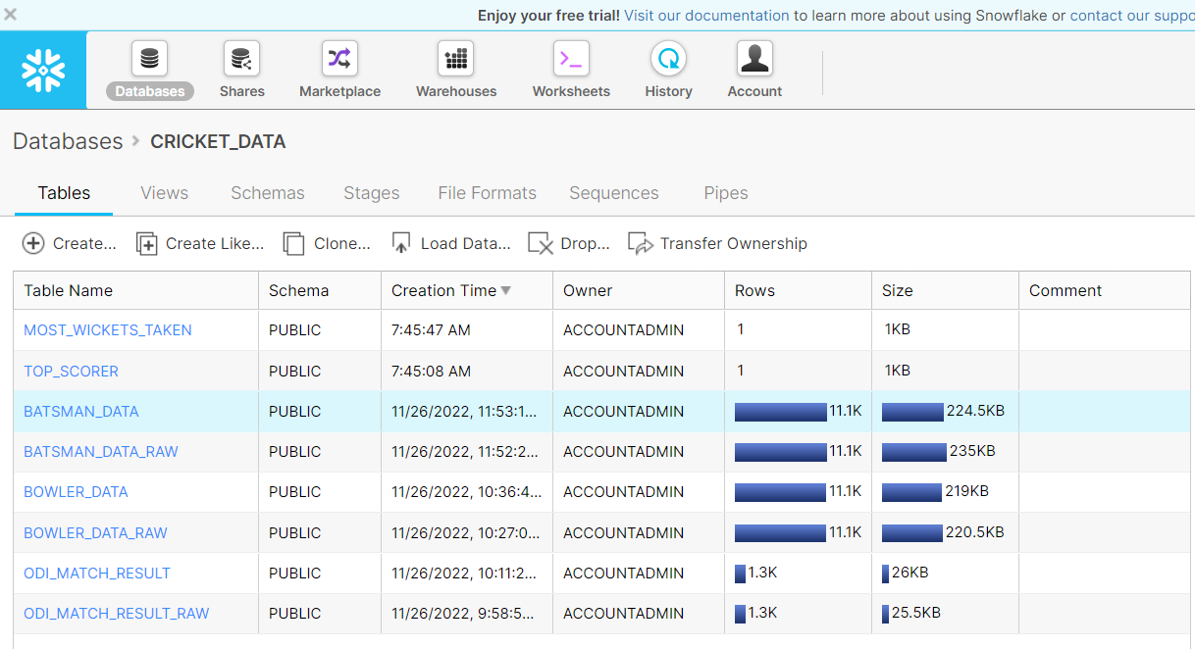
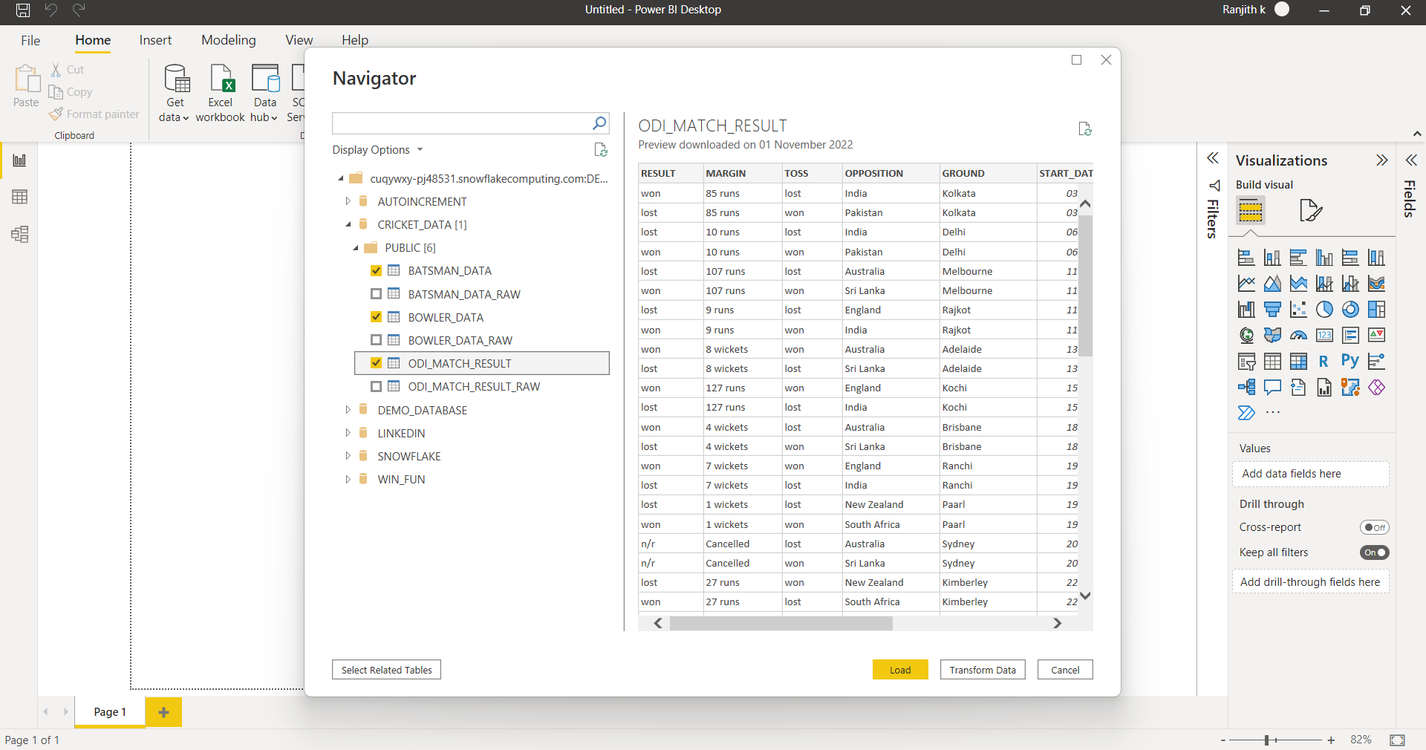
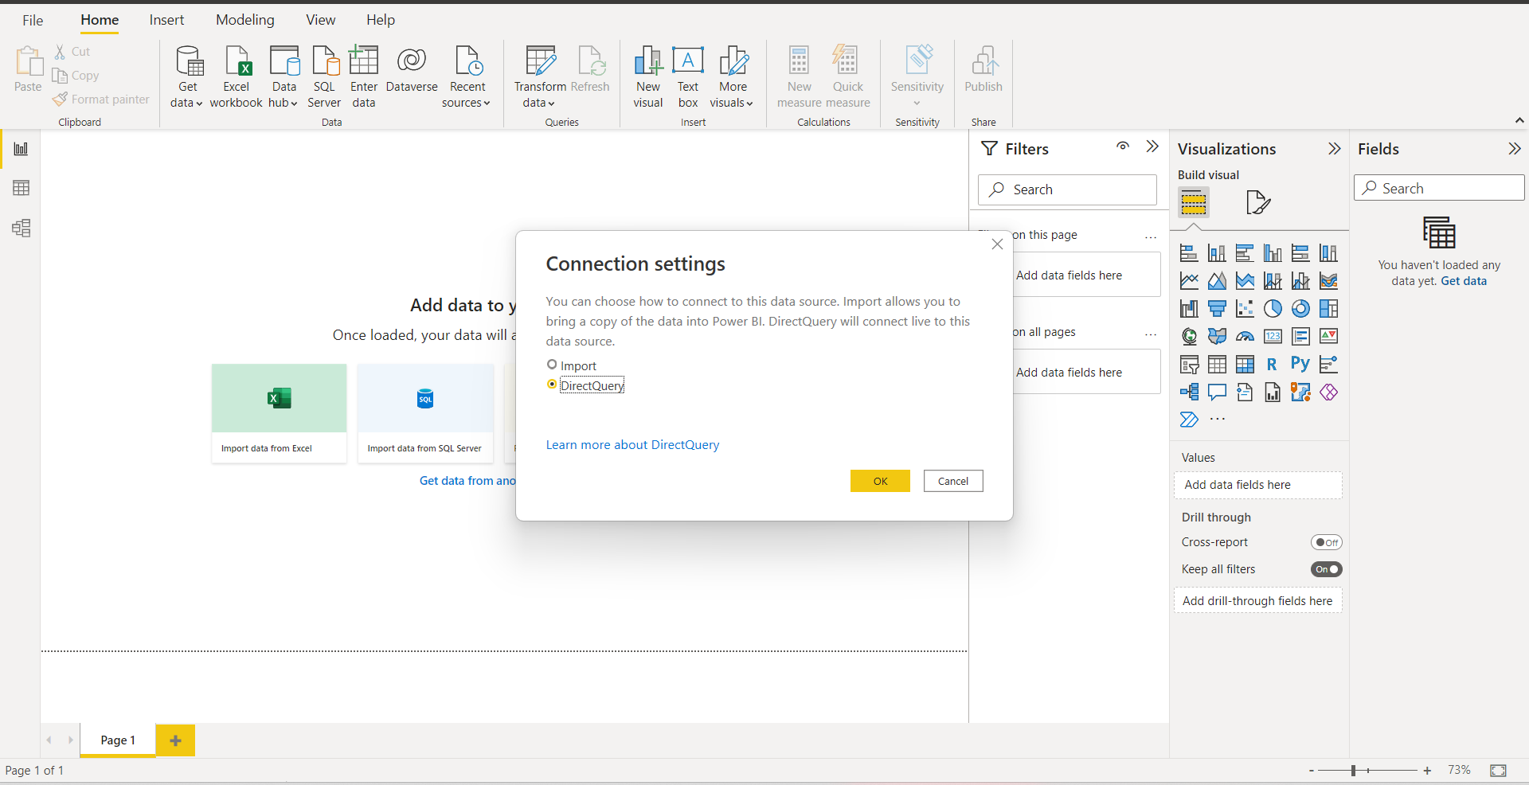
Data cleaning and importing to PBI
Uploaded raw data
Code for Data cleaning uploaded in word format
Uploaded clean data into PBI

Slide 5
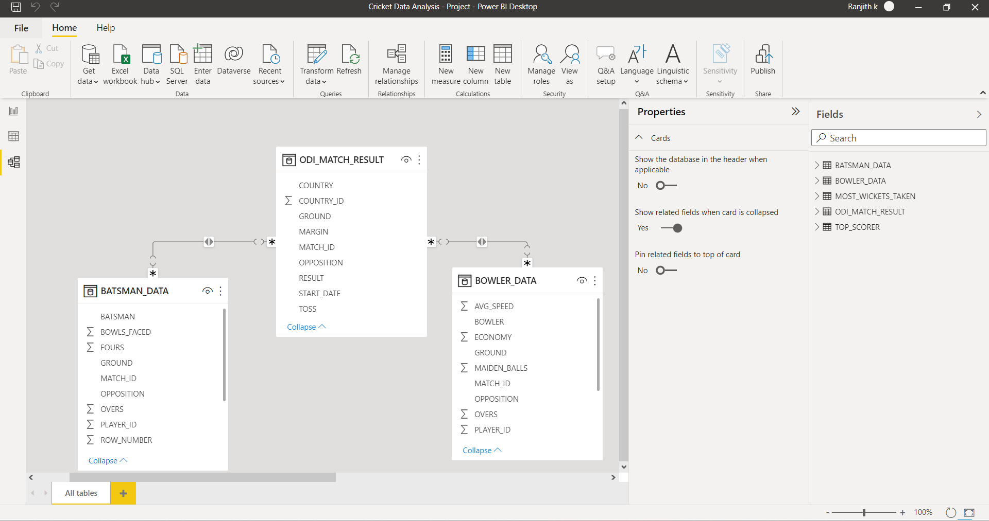
Creating relationships and changing datatype as per requirement

Slide 6
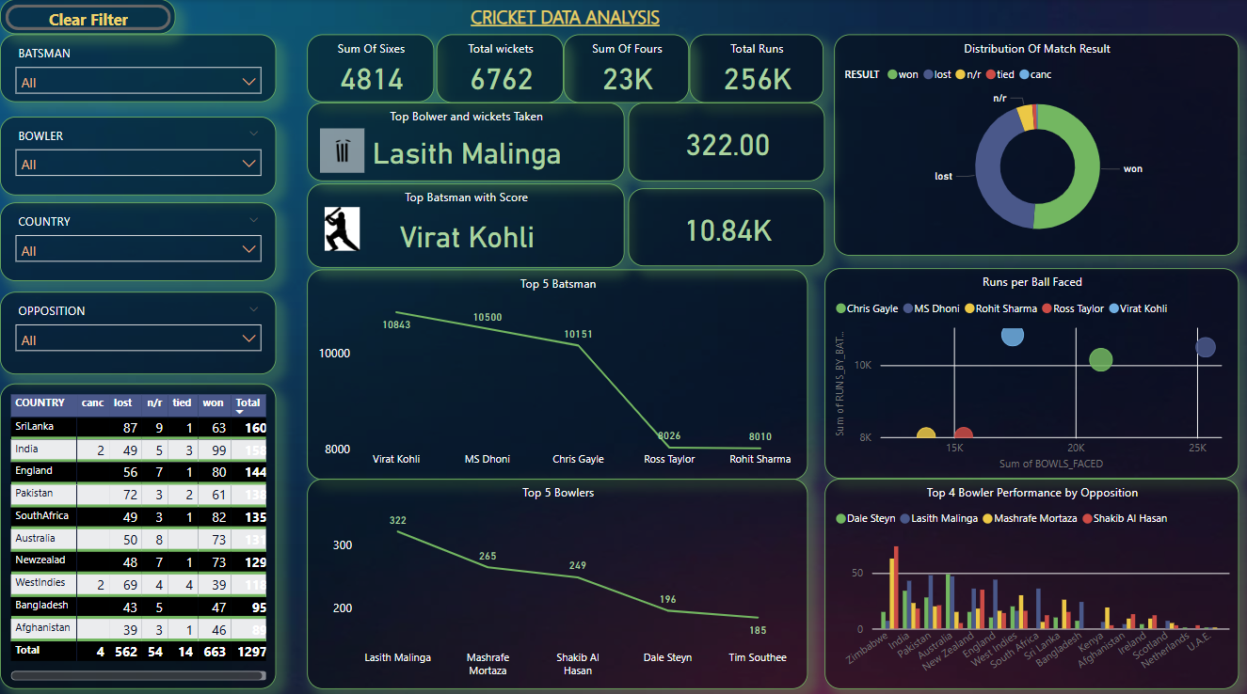
Created Insightful Dashboard
Insights / Conclusion :
Dashboard shows top 5 Batsman & Bowlers
Matrix shows Sri Lanka is the country that played in most of the matches.
Sri Lanka is the country that played in most of the matches.
South Africa is the country that won most of the matches.
Tim Southee is the Top Bowler
Rohith Sharma is the Top batsman
Lasith Malinga took maximum wickets
Virat Kohli has Maximum scores

